Slide 1
Human resources slide 1
Neural Network project
By Nima Osman

Slide 2
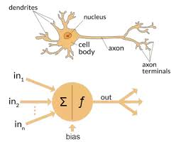
Human resources slide 2
Introduction: Neural networks
Key component of deep learning (LeCun et al., 2015) .
Mimic human brain
Notes:
References:
LeCun, Yann, et al. “Deep Learning.” Nature, vol. 521, no. 7553, May 2015, pp. 436–444, www.nature.com/articles/nature14539, https://doi.org/10.1038/nature14539.
Image-
Nagyfi Richárd. “The Differences between Artificial and Biological Neural Networks.” Medium, Towards Data Science, 4 Sept. 2018, towardsdatascience.com/the-differences-between-artificial-and-biological-neural-networks-a8b46db828b7.

Slide 3
Human resources slide 2
Introduction: Training
Epoch is an iterative process
Weights and biases (Goodfellow et al., 2016).
MSE vs Cross-Entropy loss
Notes:
References:
Goodfellow, Ian, et al. Deep Learning. Cambridge, Massachusetts, The MIT Press, 2016, www.deeplearningbook.org/.

Slide 4
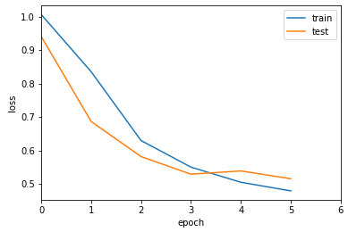
Human resources slide 2
Introduction: Key metrics
Training and validation loss (GeeksforGeeks, 2024).
Generalisation vs overfitting
Activation functions e.g. ReLU and softmax (Ali, 2024)
Notes:
References:
Ali, Moez. “Introduction to Activation Functions in Neural Networks.” Datacamp, 12 Sept. 2024, www.datacamp.com/tutorial/introduction-to-activation-functions-in-neural-networks?utm_source=google&utm_medium=paid_search&utm_campaignid=19589720824&utm_adgroupid=157156376071&utm_device=c&utm_keyword=&utm_matchtype=&utm_network=g&utm_adpostion=&utm_creative=726015683484&utm_targetid=dsa-2218886984380&utm_loc_interest_ms=&utm_loc_physical_ms=9198559&utm_content=&utm_campaign=230119_1-sea~dsa~tofu_2-b2c_3-row-p2_4-prc_5-na_6-na_7-le_8-pdsh-go_9-nb-e_10-na_11-na-jan25&gad_source=1&gclid=CjwKCAiAnKi8BhB0EiwA58DA4TxsPJDlHOP3Zs9i-dIcgM5knfEuTXRC_b8vtwCMWz-q-aeCPVDfKBoCcBkQAvD_BwE. Accessed 14 Jan. 2025.
GeeksforGeeks. “Training and Validation Loss in Deep Learning.” GeeksforGeeks, 18 Sept. 2024, www.geeksforgeeks.org/training-and-validation-loss-in-deep-learning/.
Image:
Haydar, Mohammad & Helal, Mustakim & Hossain, Syed. (2018). Sentiment Extraction From Bangla Text : A Character Level Supervised Recurrent Neural Network Approach. 1-4. 10.1109/IC4ME2.2018.8465606.

Slide 5
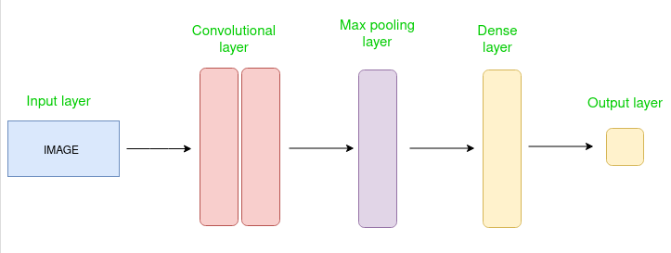
Human resources slide 2
Convolution Neural networks
Convolutional Neural Networks (CNN) are used for image-related tasks
Convolutional filters and multiple layers (Spiceworks, 2025).
Detect edges, textures shapes
Notes:
References:
“What Is a Neural Network? Definition, Working, Types, and Applications in 2022 |.” Spiceworks, 7 Jan. 2025, www.spiceworks.com/tech/artificial-intelligence/articles/what-is-a-neural-network/.

Slide 6
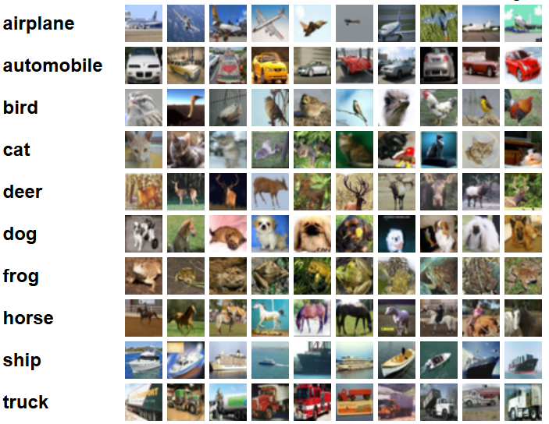
Human resources slide 2
The Dataset
CIFAR-10
Created by Alex Krizhevsky, Vinod Nair, Geoffrey Hinton.
60,000 colour images
10 distinct classes (Krizhevsky, 2009).
Notes:
References:
Krizhevsky, Alex. “CIFAR-10 and CIFAR-100 Datasets.” Toronto.edu, 2009, www.cs.toronto.edu/~kriz/cifar.html.

Slide 7
Objective Developing a neural network model using the CIFAR-10 dataset for object recognition.

Slide 8
Methodology

Slide 9
Human resources slide 2
Validation set partitioning
train_test_split function
Training set: train model
Splits original data into two subsets
Validation set: evaluate model’s performance
Notes:
References:
Krizhevsky, Alex. “CIFAR-10 and CIFAR-100 Datasets.” Toronto.edu, 2009, www.cs.toronto.edu/~kriz/cifar.html.

Slide 10
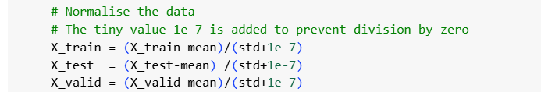
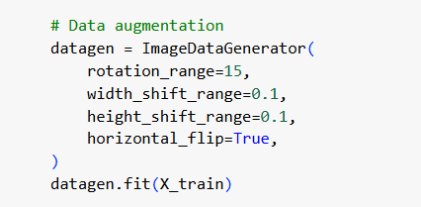
Human resources slide 3
Data Processing
NORMALISATION:
CONVOLUTIONAL LAYERS
Pixel value = [0,1] (Waiss, 2023)(Chng, 2022)
DATA AUGMENTATION
Random horizontal flipping, rotations, shifts.
Combat overfitting
Improves performance on validation data
Notes:
References:
Chng, Zhe Ming. “Using Normalization Layers to Improve Deep Learning Models.” Machine Learning Mastery, 14 June 2022, machinelearningmastery.com/using-normalization-layers-to-improve-deep-learning-models/.
Hopswork. “What Is a Model Architecture? - Hopsworks.” Www.hopsworks.ai, www.hopsworks.ai/dictionary/model-architecture.
Waiss, Sulaf. “Normalizing a Image Dataset for CNN ? | ResearchGate.” ResearchGate, 2023, www.researchgate.net/post/Normalizing_a_image_dataset_for_CNN.

Slide 11
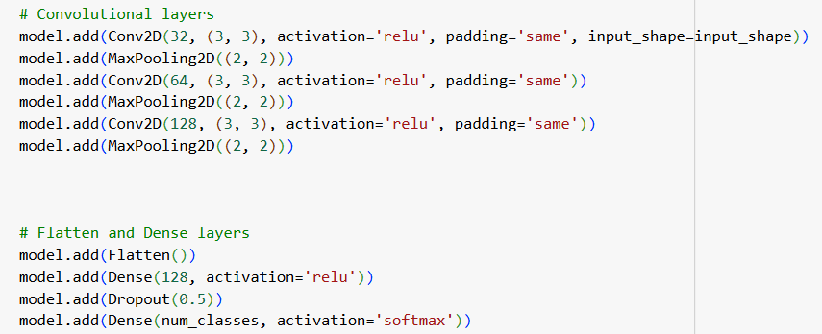
Human resources slide 3
Model Architecture
3 vs 8 layers
Complexity vs overfitting (Hopswork, 2021)
CONVOLUTIONAL LAYERS
POOLING LAYERS
Max-pooling layers for each convolutional layer
DROPOUT REGULARISATION
Added dropout layers after dense layers
Balanced dropout rate is necessary
Notes:
References:
Chng, Zhe Ming. “Using Normalization Layers to Improve Deep Learning Models.” Machine Learning Mastery, 14 June 2022, machinelearningmastery.com/using-normalization-layers-to-improve-deep-learning-models/.
Hopswork. “What Is a Model Architecture? - Hopsworks.” Www.hopsworks.ai, www.hopsworks.ai/dictionary/model-architecture.
Waiss, Sulaf. “Normalizing a Image Dataset for CNN ? | ResearchGate.” ResearchGate, 2023, www.researchgate.net/post/Normalizing_a_image_dataset_for_CNN.

Slide 12
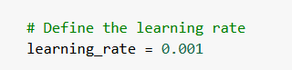
Human resources slide 3
Learning rate
Experiment with different rates 0.1- 0.0001
Adam optimiser
CONVOLUTIONAL LAYERS
LIMITATION
Manual trail and error
Hyperparameter optimisation methods - cyclical learning rates
Notes:
References:
Chng, Zhe Ming. “Using Normalization Layers to Improve Deep Learning Models.” Machine Learning Mastery, 14 June 2022, machinelearningmastery.com/using-normalization-layers-to-improve-deep-learning-models/.
Hopswork. “What Is a Model Architecture? - Hopsworks.” Www.hopsworks.ai, www.hopsworks.ai/dictionary/model-architecture.
Waiss, Sulaf. “Normalizing a Image Dataset for CNN ? | ResearchGate.” ResearchGate, 2023, www.researchgate.net/post/Normalizing_a_image_dataset_for_CNN.

Slide 13
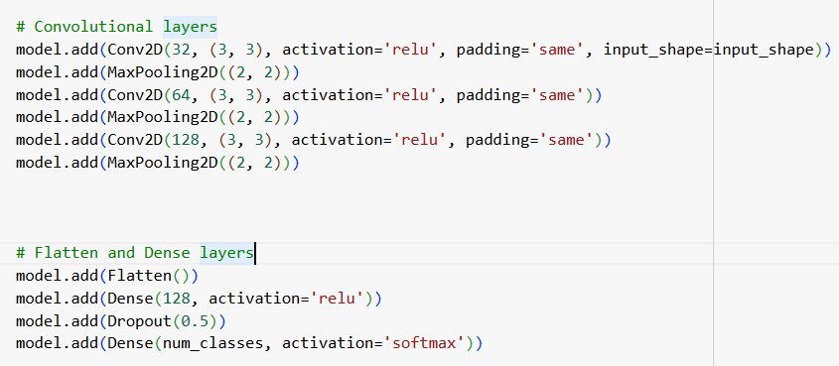
Human resources slide 3
Activation function
ReLU
Widely used in CNNs
Dying ReLu (Ali, 2024)
Notes:
References:
GeeksforGeeks. “Why Do We Use Both Validation Set and Test Set?” GeeksforGeeks, 13 Feb. 2024, www.geeksforgeeks.org/why-do-we-use-both-validation-set-and-test-set/.
GeeksforGeeks. “Training and Validation Loss in Deep Learning.” GeeksforGeeks, 18 Sept. 2024, www.geeksforgeeks.org/training-and-validation-loss-in-deep-learning/.

Slide 14
Human resources slide 3
Loss function and optimiser
Categorical cross-entropy was used
Adam optimiser was chosen
CRITIC
Should have experimented with other loss functions or optimisers
Notes:
References:
GeeksforGeeks. “Why Do We Use Both Validation Set and Test Set?” GeeksforGeeks, 13 Feb. 2024, www.geeksforgeeks.org/why-do-we-use-both-validation-set-and-test-set/.
GeeksforGeeks. “Training and Validation Loss in Deep Learning.” GeeksforGeeks, 18 Sept. 2024, www.geeksforgeeks.org/training-and-validation-loss-in-deep-learning/.

Slide 15
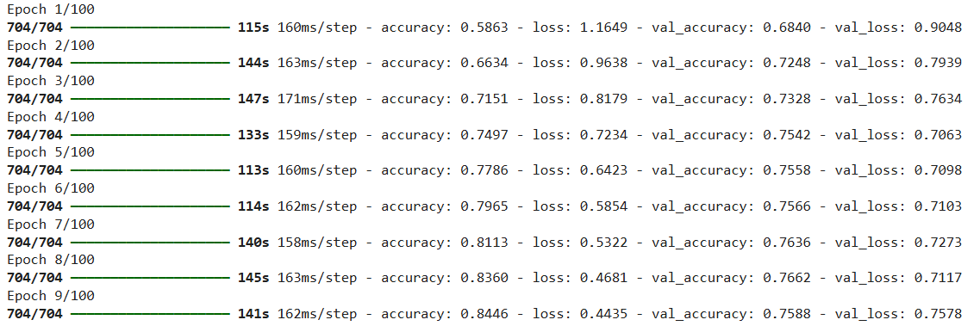
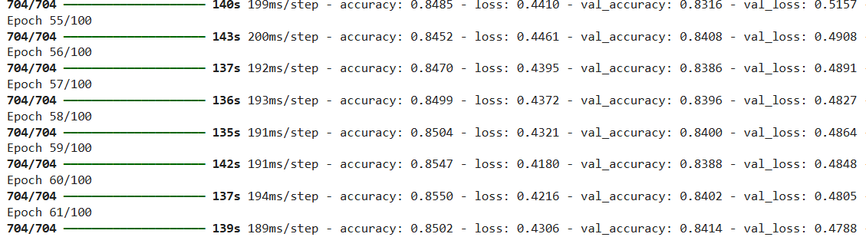
Human resources slide 3
Initial attempt
Evaluation metrics
Chose validation loss as primary evaluation metric
Initial attempts accuracy = 84% (Geeksforgeeks, 2024)
Additional metrics: precision, recall or F1 score (GeeksforGeeks, 2024)
Final attempt
Notes:
References:
GeeksforGeeks. “Why Do We Use Both Validation Set and Test Set?” GeeksforGeeks, 13 Feb. 2024, www.geeksforgeeks.org/why-do-we-use-both-validation-set-and-test-set/.
GeeksforGeeks. “Training and Validation Loss in Deep Learning.” GeeksforGeeks, 18 Sept. 2024, www.geeksforgeeks.org/training-and-validation-loss-in-deep-learning/.

Slide 16
Human resources slide 4
Stackoverflow
UNIT 9
Kaggle
Machine learning module
(Nekouei, 2023)
INSPIRATION AND RESOURCES
Notes:
References:
Nekouei, Farzad. “CIFAR-10 Image Classification with CNN.” Kaggle.com, Kaggle, 19 Aug. 2023, www.kaggle.com/code/farzadnekouei/cifar-10-image-classification-with-cnn#Step-2-%7C-Data-Preparation-and-Exploration. Accessed 19 Jan. 2025.

Slide 17
Findings

Slide 18
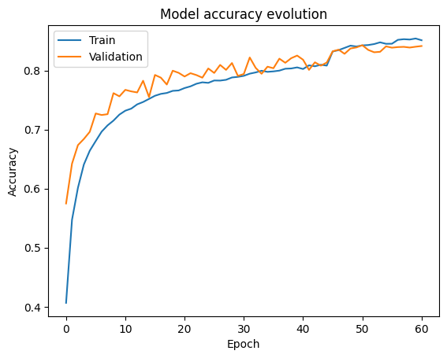
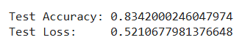
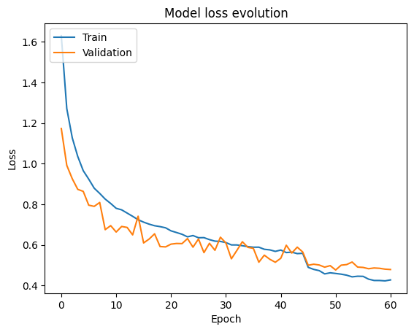
Human resources slide 5
MODEL PERFORMANCE
MODEL ACCURACY EVOLUTION
Improve in accuracy
overfitting
GRADIENT OF DESCENT
Loss decreases over time
Overfitting

Slide 19
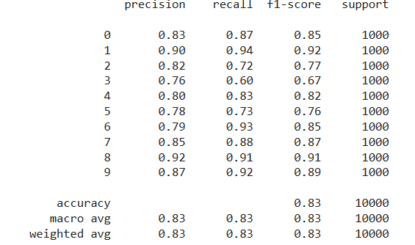
Human resources slide 5
CLASSIFICATION REPORT
CLASS-WISE PERFORMANCE
Able to identify positive instances
Able to capture all positive instances
Difference in classes
OVERALL PERFORMANCE
Good overall accuracy (0.83)
Consistent performance across classes

Slide 20
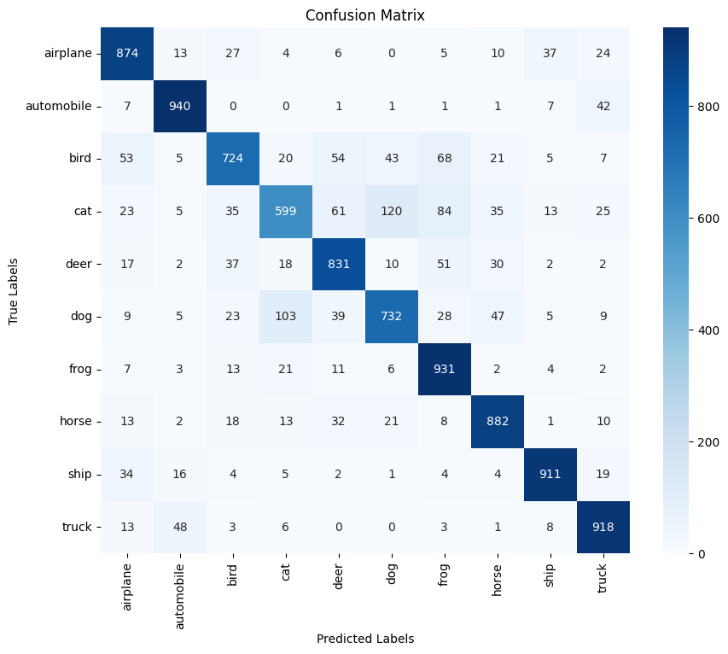
Human resources slide 5
CONFUSION MATRIX
PERFORMS WELL IN ALL CLASSES
SOME MISCLASSIFCATIONS
“cat” and “dog”
Differences across classes

Slide 21
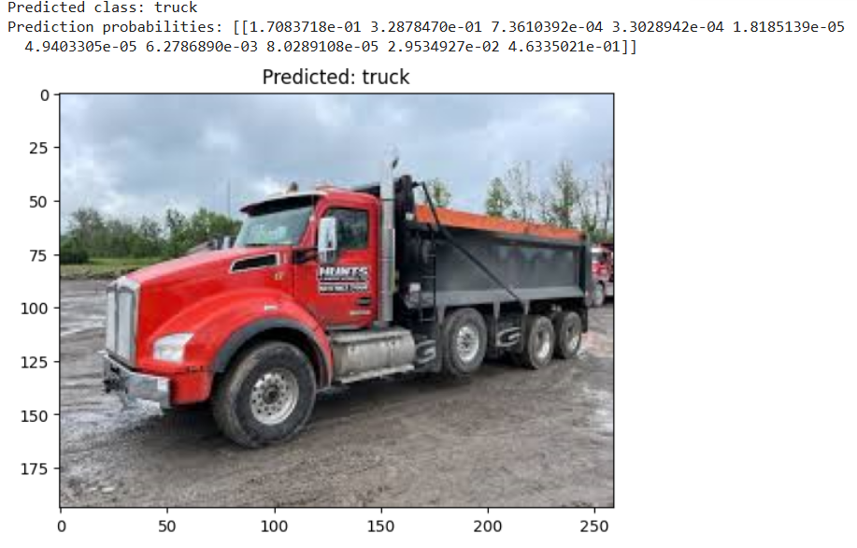
Human resources slide 5
FINAL PREDICTION
MODEL SUCCESSFULLY IDENTIFIED THE IMAGE DEPICTING A TRUK WITH A HIGH DEGREE OF CONFIDENCE

Slide 22

Human resources slide 8
CHALLENGES AND INSIGHTS
BALANCING MODEL COMPLEXITY AND GENERALISATION
HYPERPARAMETER TUNING
UNEVEN DISTRIBUTION OF CLASS PERFORMANCE
DEEP DIVE INTO MISCLASSIFIED CLASSES
DEEPER ARCHITECTURES
AUTOMATED HYPERPARAMTER OPTIMISATION

Slide 23
Human resources slide 8
CONCLUSION
TEST ACCURACY OF 83.42%
AREAS OF MISCLASSIFICATION
OVERFITTING INDICATES ROOM FOR IMPROVEMENT
AREAS FOR IMPROVEMENT:
Automated hyperparameter optimisation
Deeper architectures
Better data augmentation techniques

Slide 24
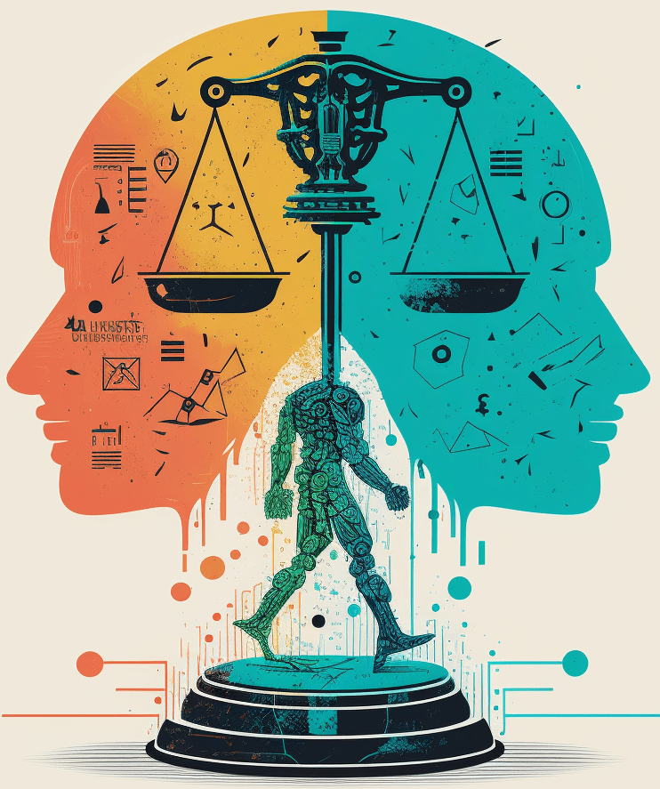
Human resources slide 8
Ethical and Real-world problems
Misclassification can lead to larger problems:
Misdiagnosis in Healthcare
Racial bias
Mistaken identity

Slide 25
References:
“What Is a Neural Network? Definition, Working, Types, and Applications in 2022 |.” Spiceworks, 7 Jan. 2025, www.spiceworks.com/tech/artificial-intelligence/articles/what-is-a-neural-network/.
Ali, Moez. “Introduction to Activation Functions in Neural Networks.” Datacamp, 12 Sept. 2024, www.datacamp.com/tutorial/introduction-to-activation-functions-in-neural-networks?utm_source=google&utm_medium=paid_search&utm_campaignid=19589720824&utm_adgroupid=157156376071&utm_device=c&utm_keyword=&utm_matchtype=&utm_network=g&utm_adpostion=&utm_creative=726015683484&utm_targetid=dsa-2218886984380&utm_loc_interest_ms=&utm_loc_physical_ms=9198559&utm_content=&utm_campaign=230119_1-sea~dsa~tofu_2-b2c_3-row-p2_4-prc_5-na_6-na_7-le_8-pdsh-go_9-nb-e_10-na_11-na-jan25&gad_source=1&gclid=CjwKCAiAnKi8BhB0EiwA58DA4TxsPJDlHOP3Zs9i-dIcgM5knfEuTXRC_b8vtwCMWz-q-aeCPVDfKBoCcBkQAvD_BwE. Accessed 14 Jan. 2025.
Chng, Zhe Ming. “Using Normalization Layers to Improve Deep Learning Models.” Machine Learning Mastery, 14 June 2022, machinelearningmastery.com/using-normalization-layers-to-improve-deep-learning-models/.
GeeksforGeeks. “Training and Validation Loss in Deep Learning.” GeeksforGeeks, 18 Sept. 2024, www.geeksforgeeks.org/training-and-validation-loss-in-deep-learning/.
GeeksforGeeks. “Why Do We Use Both Validation Set and Test Set?” GeeksforGeeks, 13 Feb. 2024, www.geeksforgeeks.org/why-do-we-use-both-validation-set-and-test-set/.
Goodfellow, Ian, et al. Deep Learning. Cambridge, Massachusetts, The MIT Press, 2016, www.deeplearningbook.org/.
Haydar, Mohammad & Helal, Mustakim & Hossain, Syed. (2018). Sentiment Extraction From Bangla Text : A Character Level Supervised Recurrent Neural Network Approach. 1-4. 10.1109/IC4ME2.2018.8465606.
Hopswork. “What Is a Model Architecture? - Hopsworks.” Www.hopsworks.ai, www.hopsworks.ai/dictionary/model-architecture.
Krizhevsky, Alex. “CIFAR-10 and CIFAR-100 Datasets.” Toronto.edu, 2009, www.cs.toronto.edu/~kriz/cifar.html.
LeCun, Yann, et al. “Deep Learning.” Nature, vol. 521, no. 7553, May 2015, pp. 436–444, www.nature.com/articles/nature14539, https://doi.org/10.1038/nature14539.
Nagyfi Richárd. “The Differences between Artificial and Biological Neural Networks.” Medium, Towards Data Science, 4 Sept. 2018, towardsdatascience.com/the-differences-between-artificial-and-biological-neural-networks-a8b46db828b7.
Nekouei, Farzad. “CIFAR-10 Image Classification with CNN.” Kaggle.com, Kaggle, 19 Aug. 2023, www.kaggle.com/code/farzadnekouei/cifar-10-image-classification-with-cnn#Step-2-%7C-Data-Preparation-and-Exploration. Accessed 19 Jan. 2025.
Waiss, Sulaf. “Normalizing a Image Dataset for CNN ? | ResearchGate.” ResearchGate, 2023, www.researchgate.net/post/Normalizing_a_image_dataset_for_CNN.

Slide 26
Human resources slide 10
Thank You
This is the end of my presentation. Thank you for listening.

